Slide 1
Linear Regression using Boston Housing Data
Name: Bhakti Ukey(002922939)
Date: 2nd of February 2022

Slide 2
What are we trying to do?
We are trying to find the correlation between the independent variable and the dependent variable in-order to improve the performance of the model.
If we train a model with irrelevant columns then it impacts the performance of the model badly .
In-order to avoid this we are trying to reduce the number of columns that do not have strong correlation with the dependent variable.
Library used: Statsmodel
Statsmodel is a Python package that allows to explore data, estimate statistical models and perform statistical tests.

Slide 3
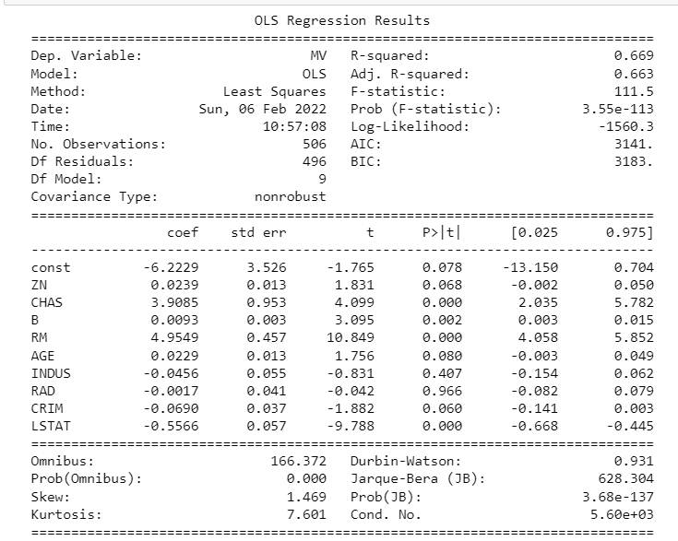
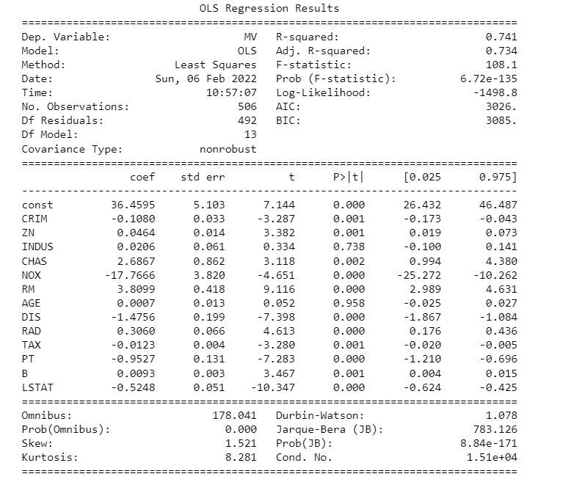
Results
R-Squared value with all dependent variable (left)and R squared after removing a few of them(right)

